Slide 1

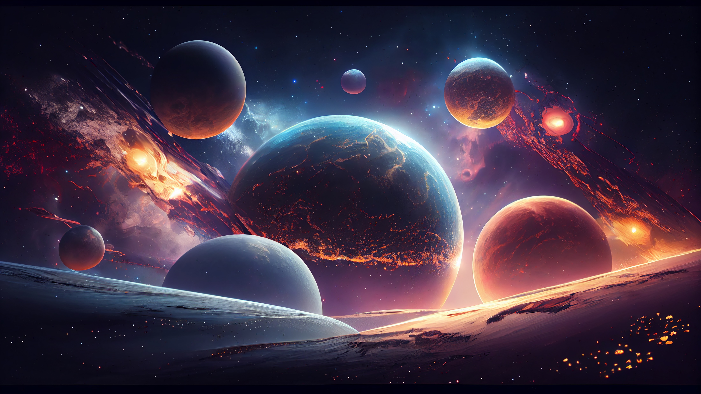

PROJECT
NEBULA

Slide 2

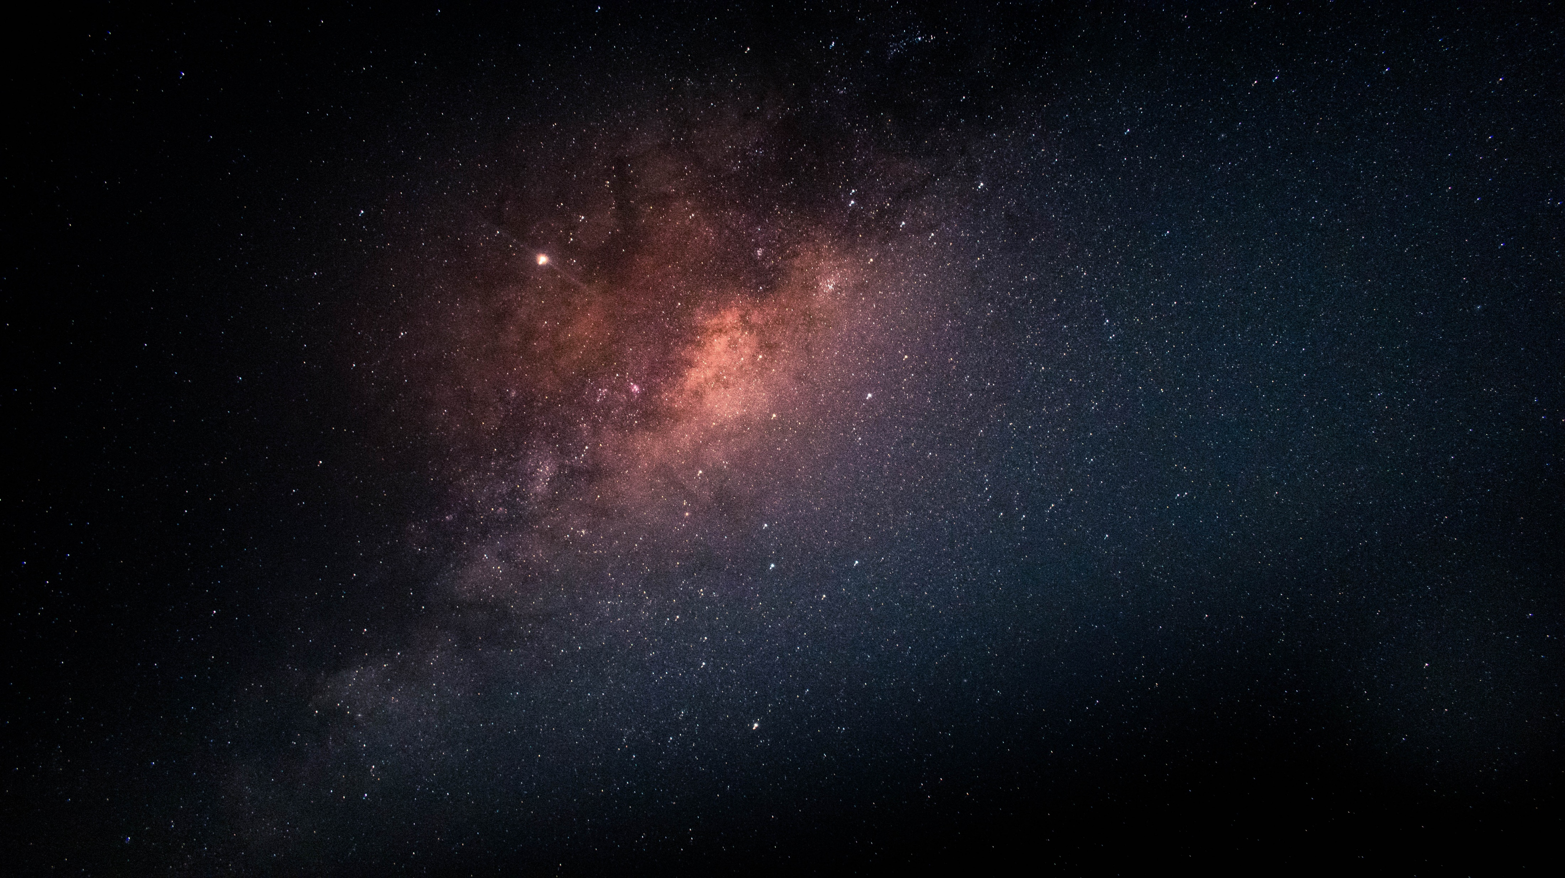

INTRODUCTION
OVERVIEW:
Brief introduction to exoplanets and their significance in Astronomy.
OBJECTIVE:
To create an interactive 3D visualization of exoplanets and surrounding stars.

Slide 3
TECHNOLOGIES USED:
Backend:
Flask: For building the web application and API.
Frontend:
Three.js: For rendering 3D visualizations of stars and exoplanets.
Data Sources:
NASA Exoplanet Archive: For exoplanet data.
Gaia:
For star data.Chatbot Integration:
OpenAI ChatGPT API:
For providing interactive information about exoplanets.

Slide 4
HOW IT WORKS
Data Retrieval:
Fetches exoplanet data using the NASA Exoplanet Archive API.
Retrieves star data from the Gaia database based on the exoplanet's coordinates.
3D Rendering:
Converts RA and Dec coordinates to Cartesian coordinates for 3D visualization.
Renders the star map in a web-based interface.

Slide 5
FEATURES
Interactive 3D Visualization:
Users can explore the 3D star map.
Search Functionality:
Users can search for specific exoplanets by name.
Chatbot Integration:
Users can ask questions about exoplanets and receive informative responses from ChatGPT.

Slide 6
USER EXPERIENCE
Interface Design:
Overview of the layout (include a screenshot or mockup).
User Journey:
Describe how users interact with the application from searching for an exoplanet to engaging with the chatbot.

Slide 7

CONCLUSION AND FUTURE WORKS
Conclusion:
Recap the project's goals and achievements.
Future Enhancements:
Potential features for future versions (e.g., enhanced data visualization, additional data sources, or improved chatbot capabilities).

Slide 8

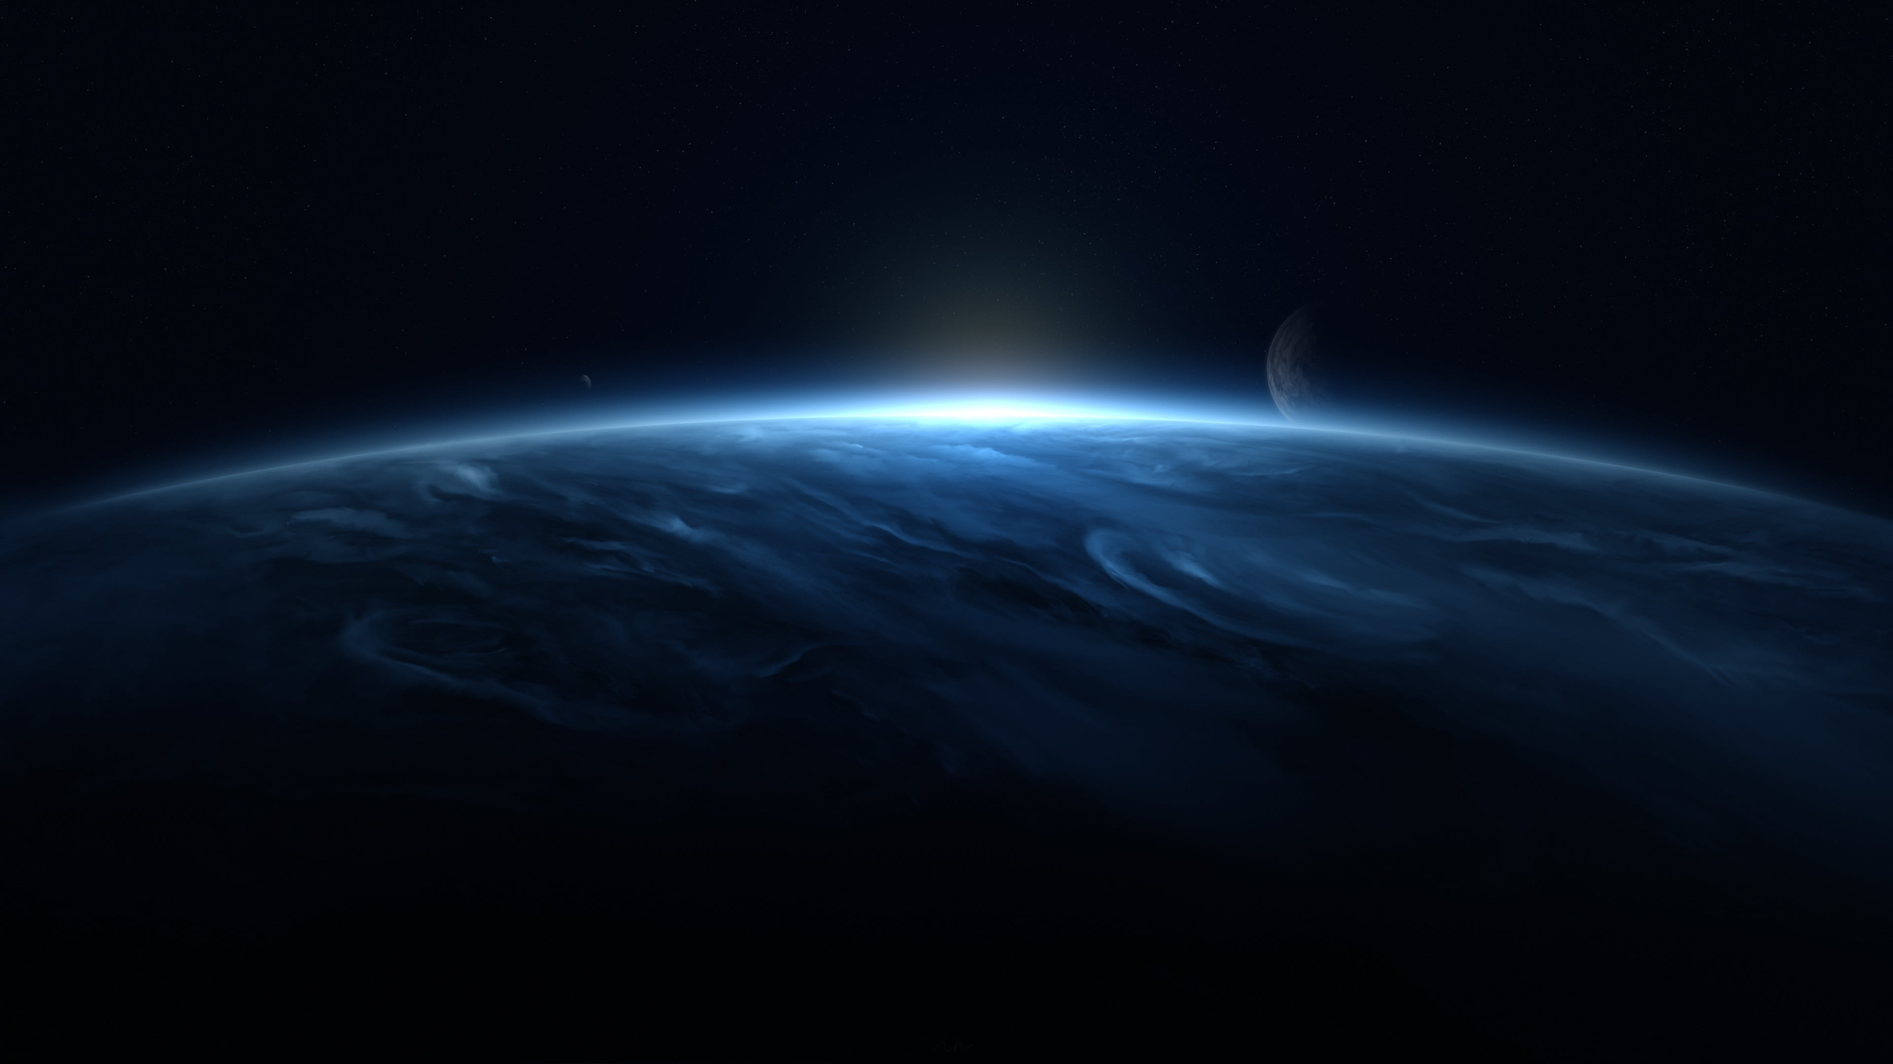
TEAM MAVERICK
SHAWN CHERIYAN SONY
SREYA V
SRYSHNAV CM

Slide 9
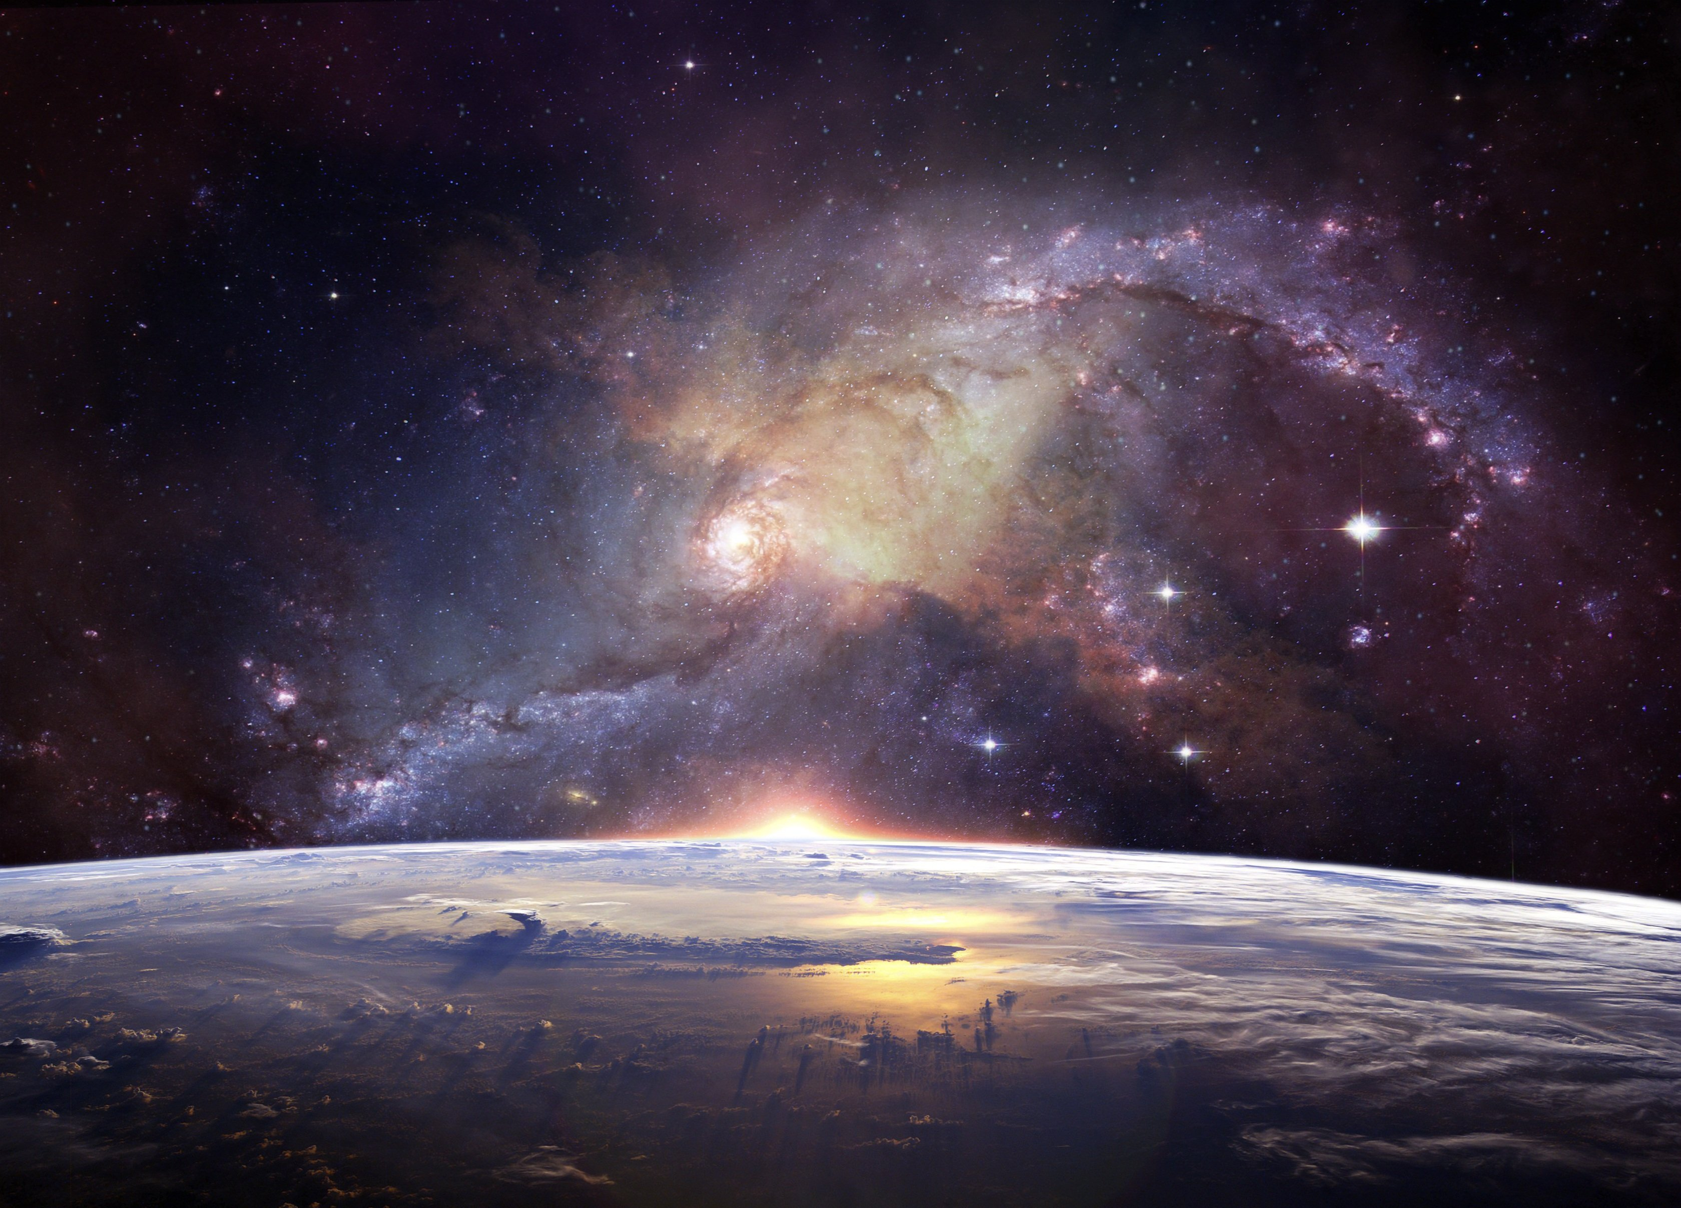
THANK YOU

